Slide 1

Zillow Home Value Prediction
Efaz Hossain

Slide 2
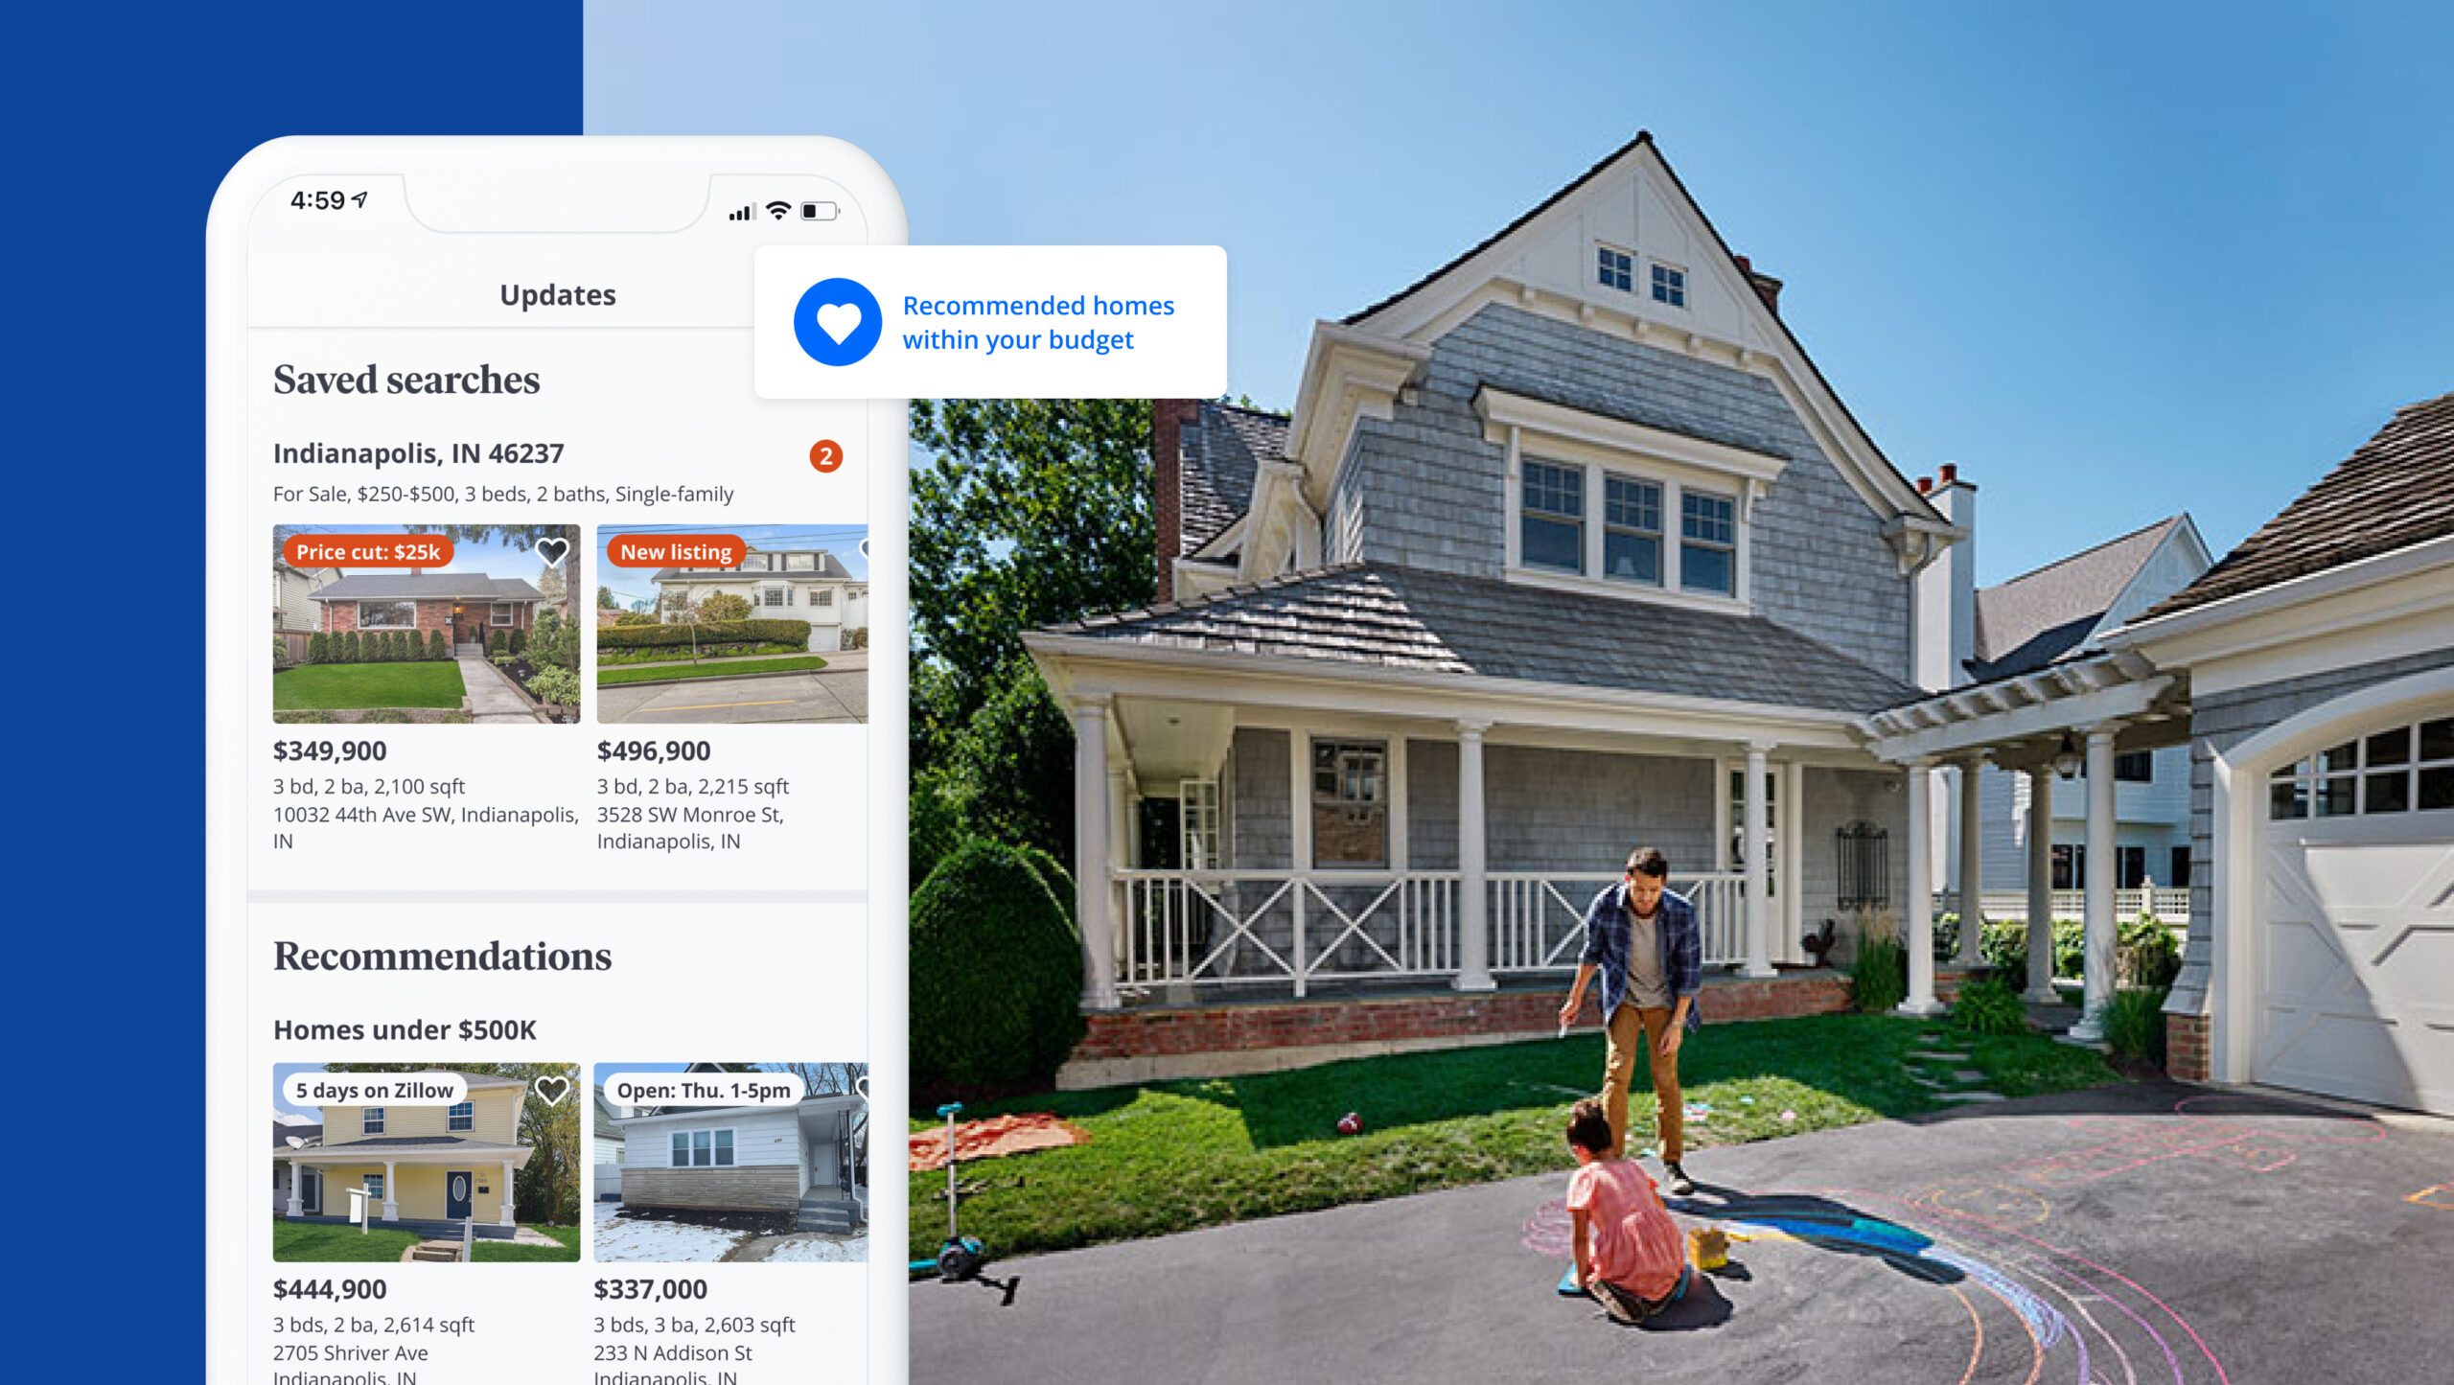
Project Background
The Zillow Home Estimate Kaggle challenge tasked participants with creating machine learning models to predict home sale prices using a dataset provided by Zillow. The goal was to improve Zillow's Zestimate algorithm for estimating home values. Competitors aimed to develop accurate predictive models by analyzing features like square footage, location, and more.

Slide 3


Objective
The objective of this challenge is to develop a model that accurately predicts the log-error between the actual sale price and the predicted sale price of homes in Los Angeles County over a specific period of time (2016-2017).

Slide 4

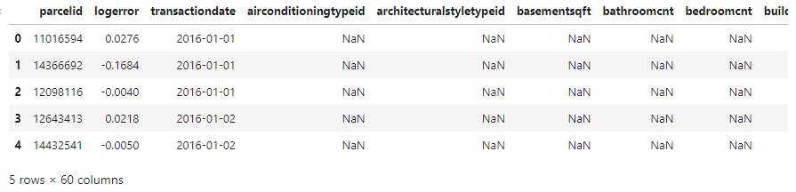
Dataset content
Provided with four datasets
Two related to properties sold in 2016 and 2017
Two training sets containing all transactions for specific properties
Features: parcelid, logerror, transactiondate, and around 59 additional columns describing each property

Slide 5
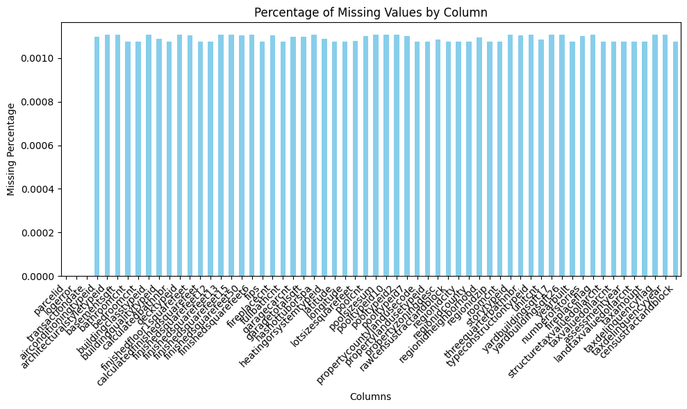
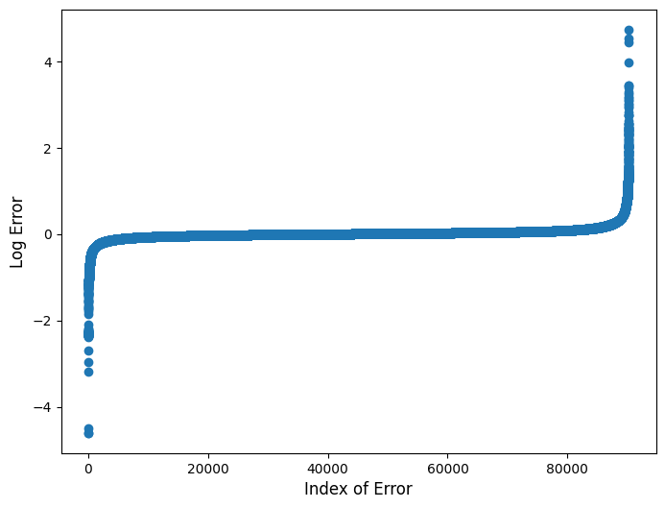
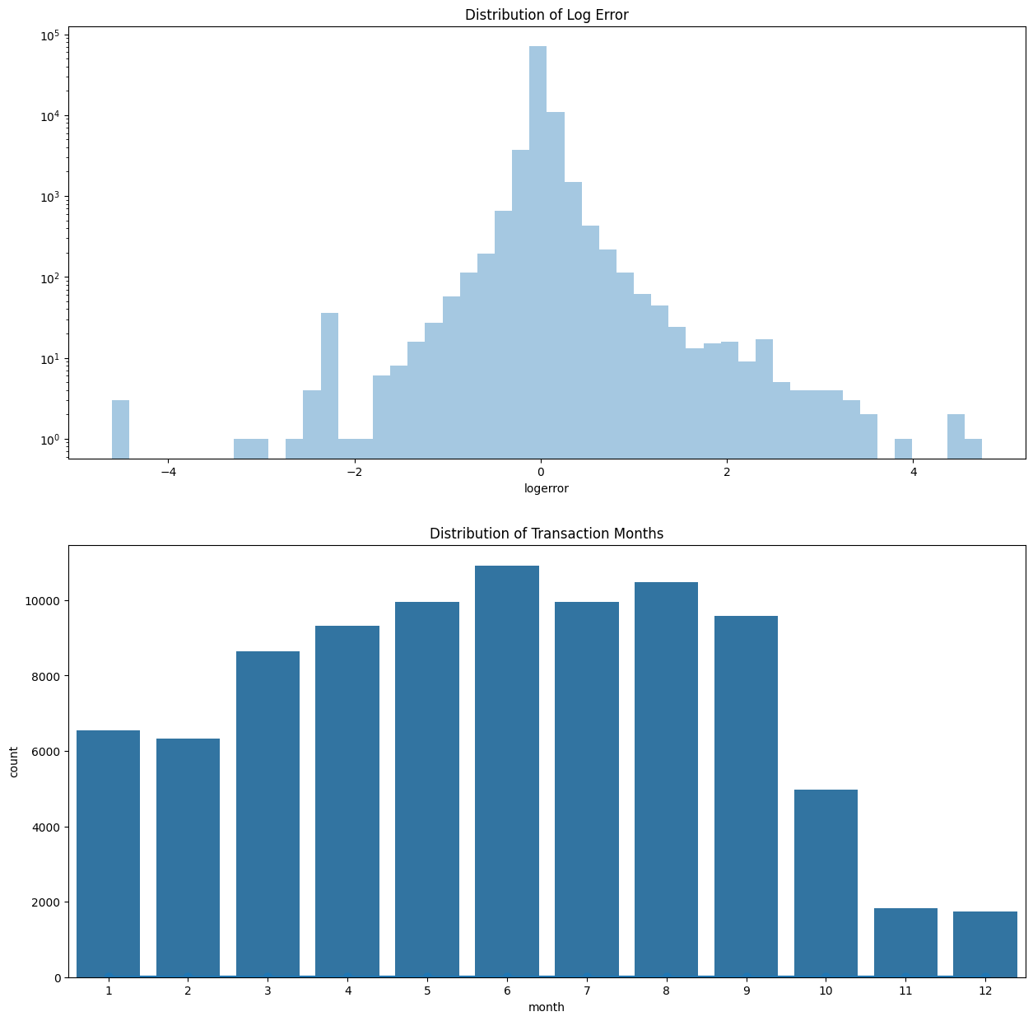
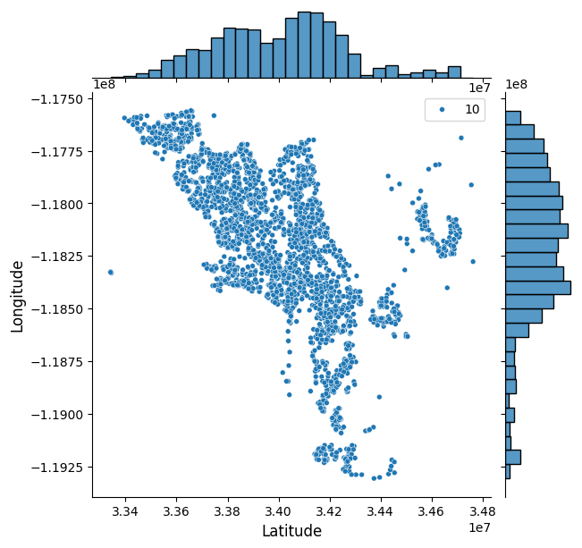
Exploratory Data Analysis (EDA)
The EDA conducted for this challenge consisted of these quick points
Approximately 90,275 properties are used in training the model for this challenge
Distribution of the Log Error and the Months of Transactions
Outliers did exist in the Log Error distributions
Overall location of each property in the California region

Slide 6
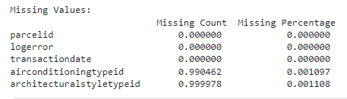
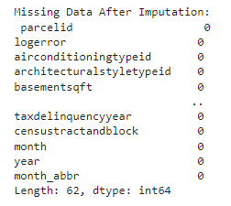
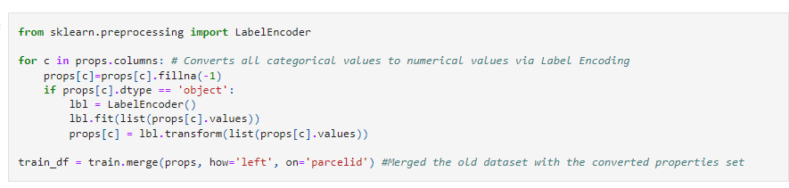
Data Preprocessing
`
This dataset had a ton of missing data after merging the train and properties dataset, and to alleviate it, these methods were conducted
Checking for Missing/Null Values
If Missing, impute the dataset with..
Mode (Categorical)
Mean (Normally Distributed Categories)
Median (Highly-skewed Categories)
Encode categorical variables with LabelEncoder

Slide 7
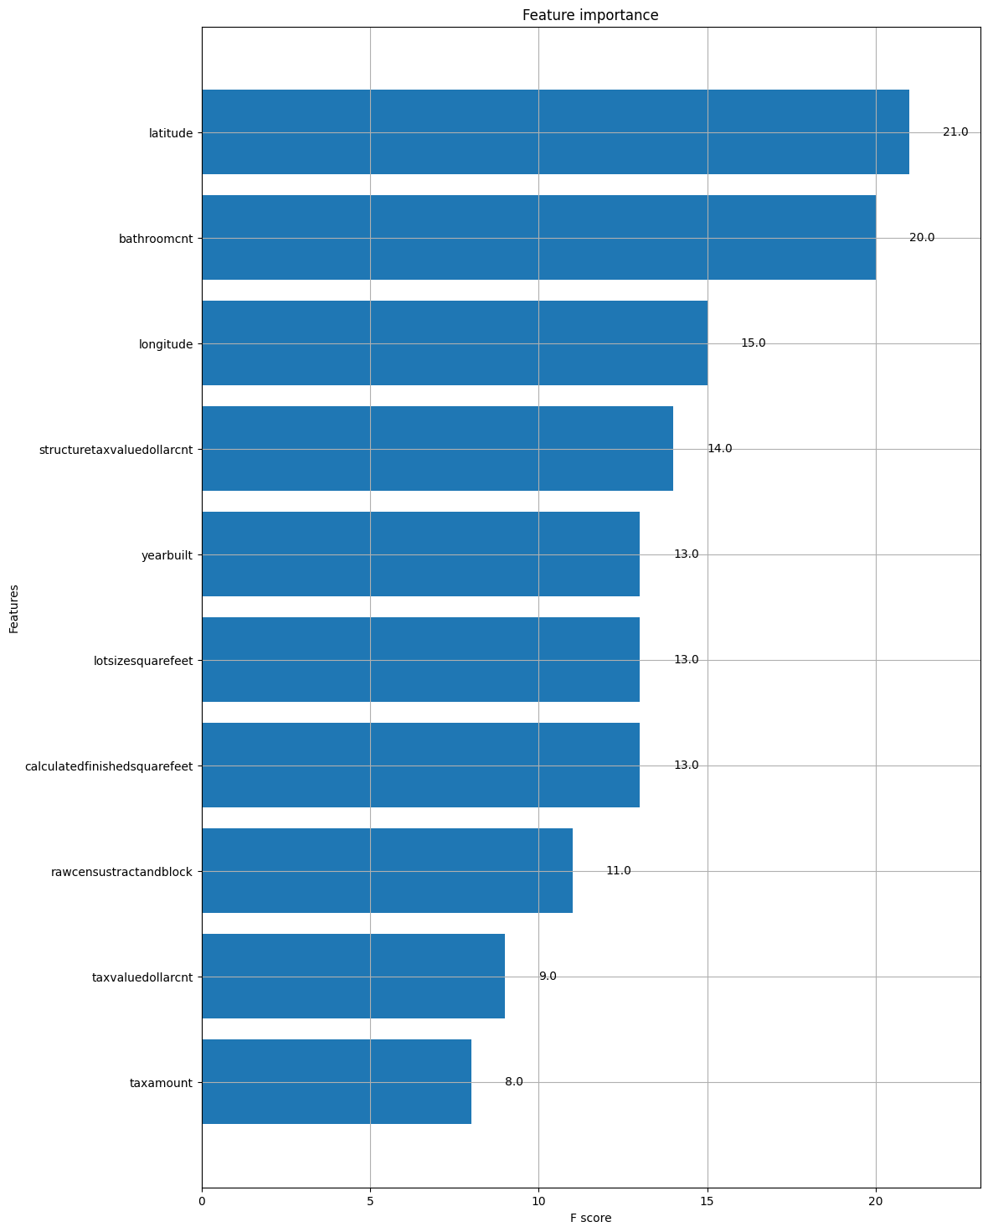
Feature Importance
Of the 58 categories for each property, only these 10 contain the most importance in determining the best model fit. But only four takes up more than 70% of the feature importance in this dataset.
Latitude/Longitude describe where the property is in the Southern California region
Bathroomcnt describe how many bathrooms a property contains
Structuretaxvaluedollarcnt describes the assessed land value of the property

Slide 8
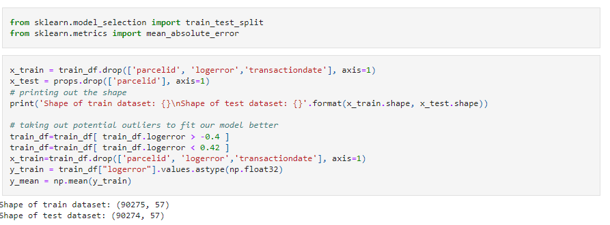
Data Splitting
Before we decide on a model, we first must split the dataset evenly, so the model has no issues whatsoever to run through it
To do this, the training and test sets were split as such
X_train: contains every column EXCEPT parcelid/logerror/transactiondate
X_test: every column EXCEPT parcelid
Y_train: contains only the log-error
Y_mean: Base average for model

Slide 9
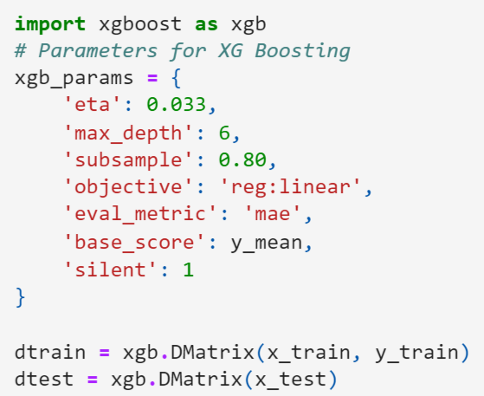
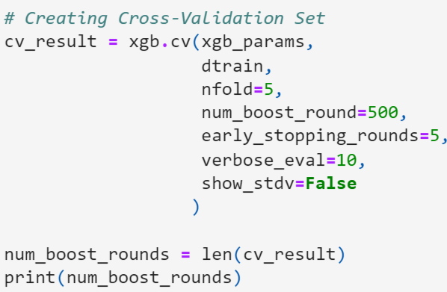

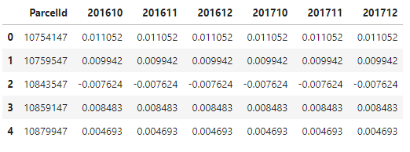
Model Selection and Performance
For this challenge, I decided to use an ensemble learning model, XGBoost
Performance Metric: Mean-Absolute Error (MAE)
Cross-Validation Set: 5-Fold Validation
The bottom two images shows the output of predicting the log-error of each property using the last three months of the year2016 and using it to predict 2017’s log error.

Slide 10
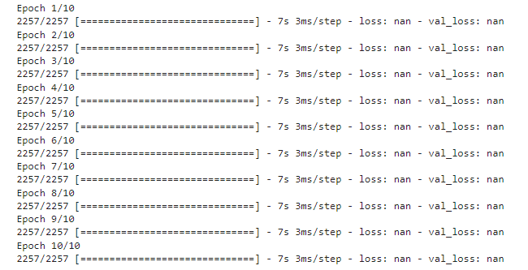
Conclusion
Future Work
This score indicates that, on average, the model's predictions deviate by approximately 0.5331 from the actual log error differences. By comparing this score with others and evaluating performance on different subsets of the data, strengths and areas for improvement can be identified. Lower log error differences suggest potential enhancements to Zillow's property valuation algorithm, which could lead to improved user satisfaction and platform competitiveness.
Future work may involve exploring alternative modeling techniques or incorporating additional data sources to further refine predictive accuracy and address any remaining challenges
A Deep Learning Model was attempted but results were not up to standards

Slide 11

Thank You

